Slide 1
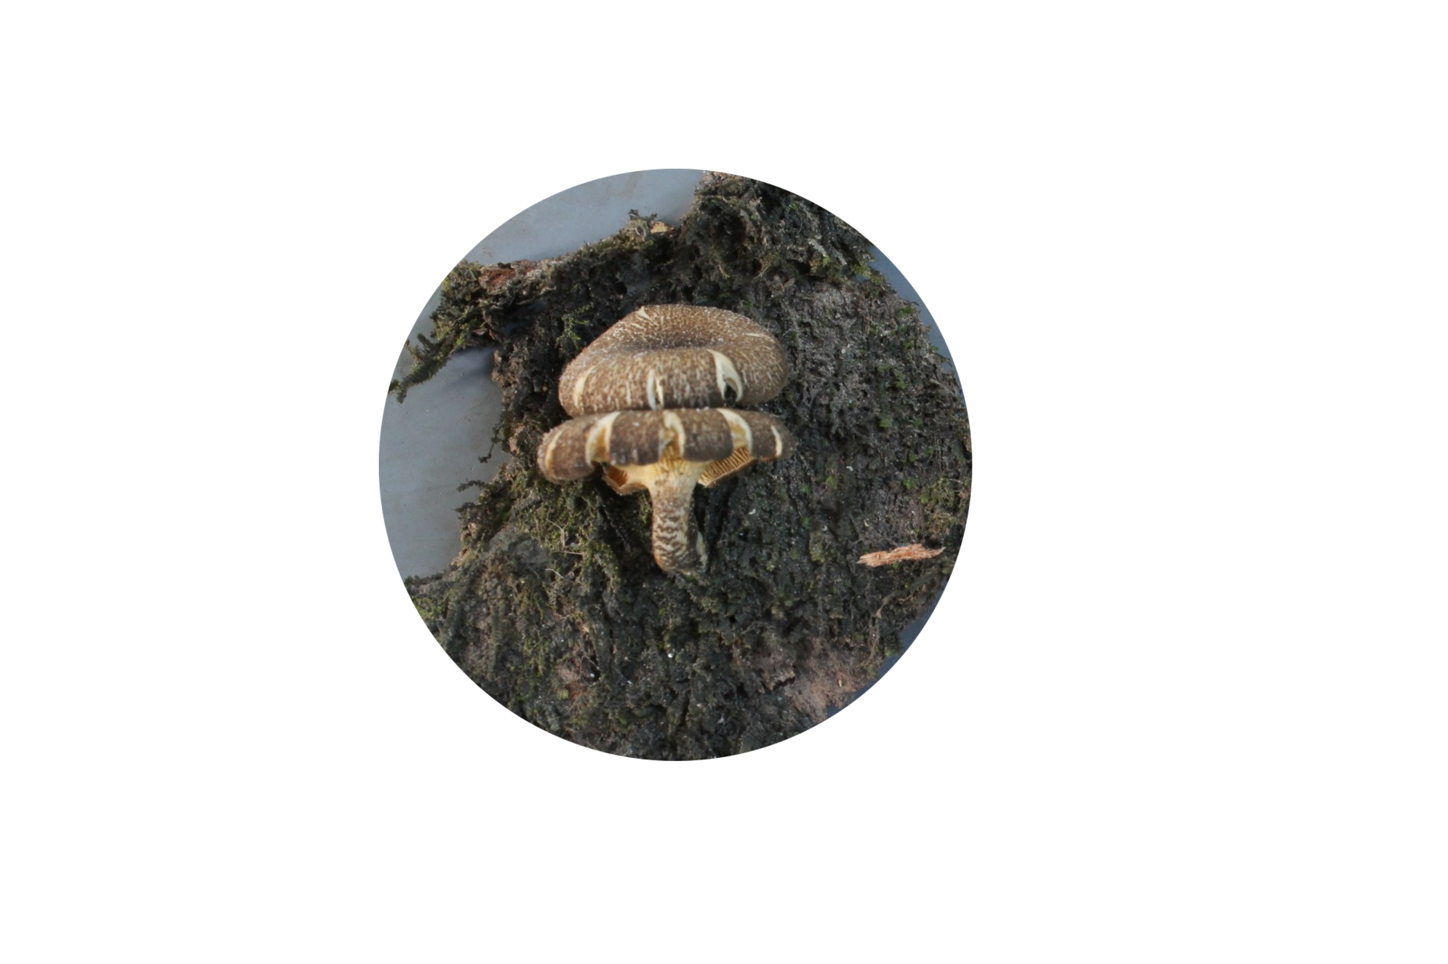
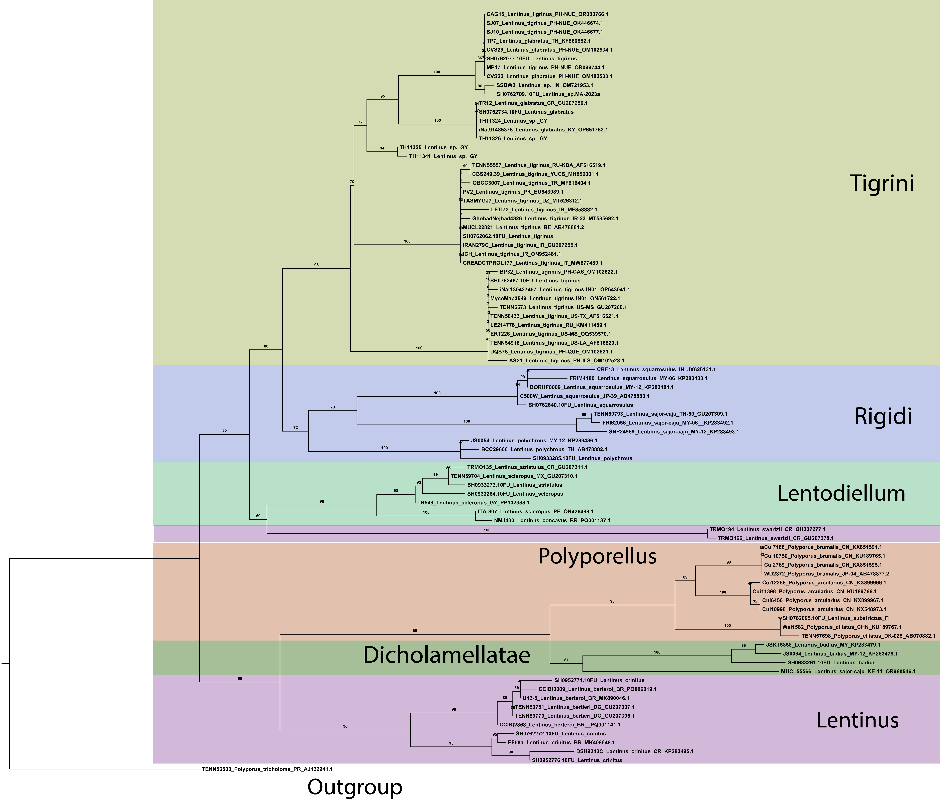
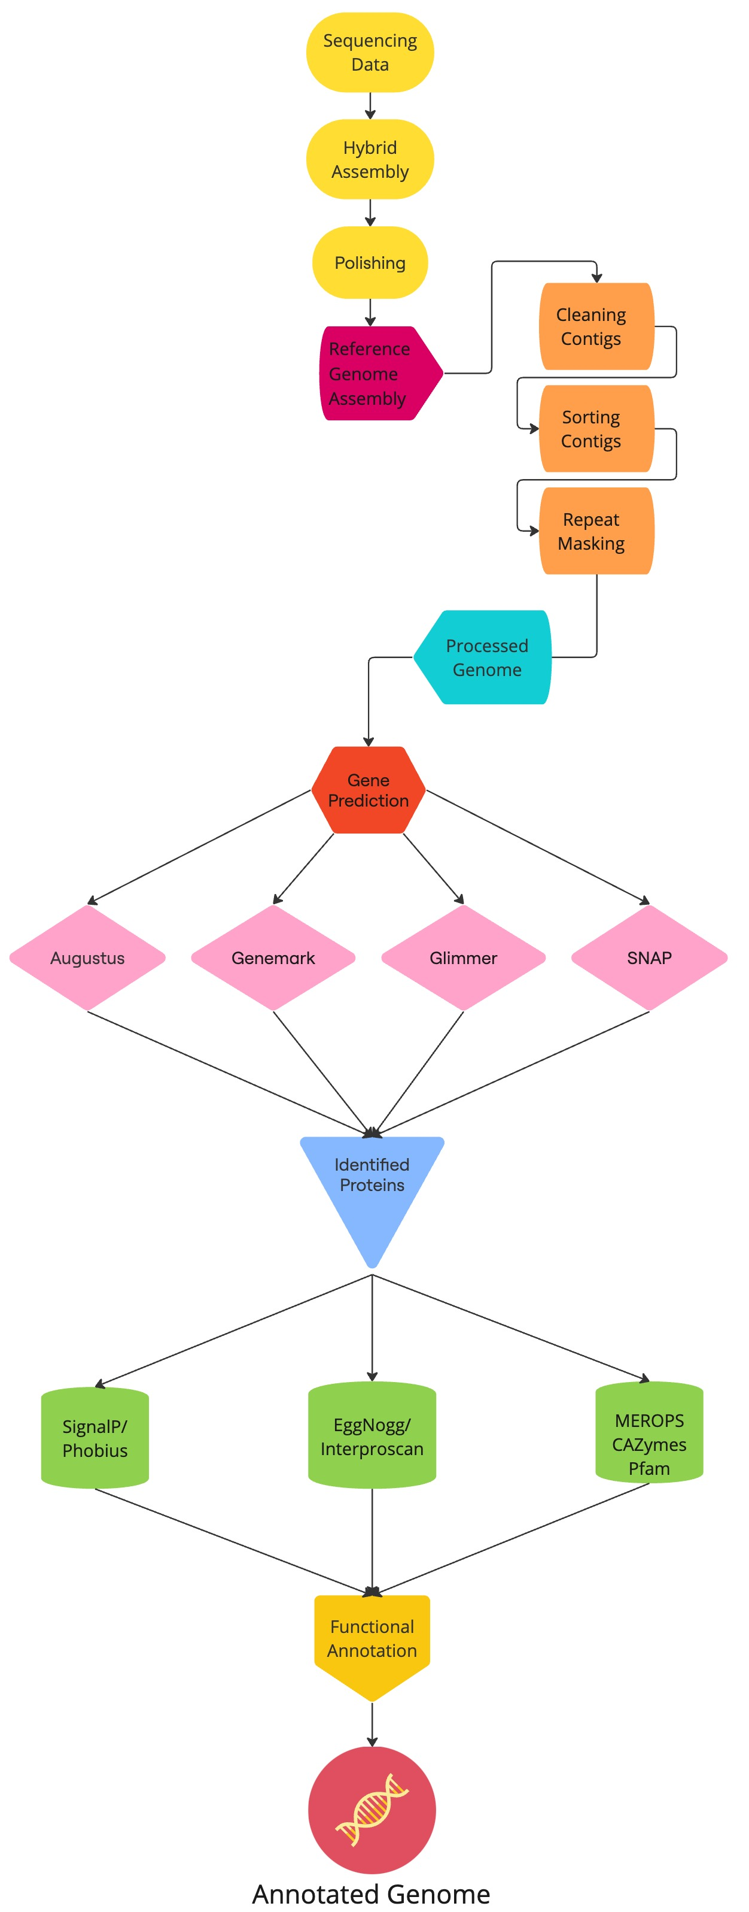
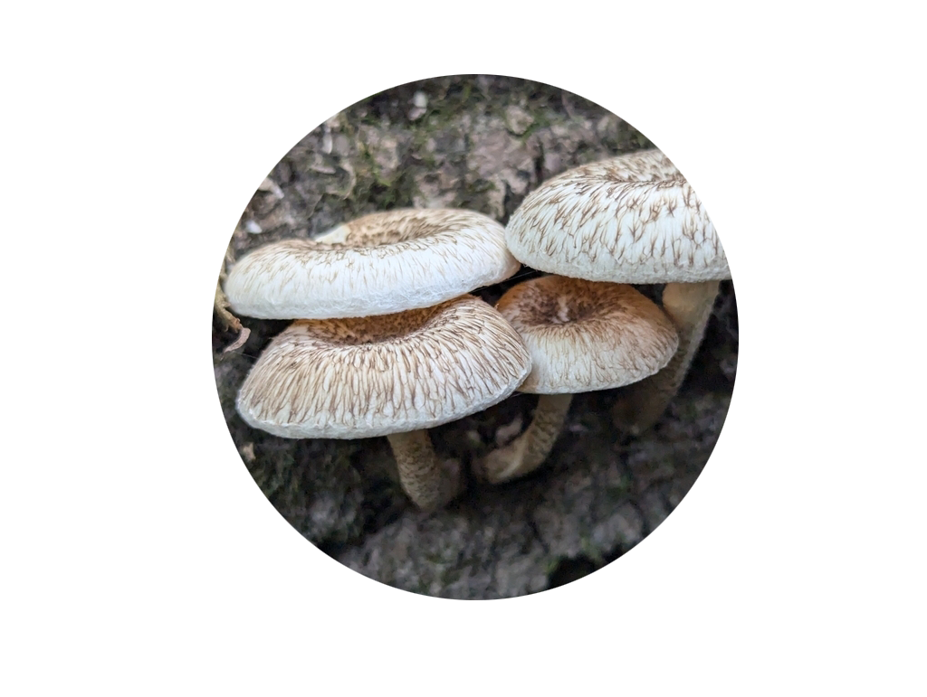
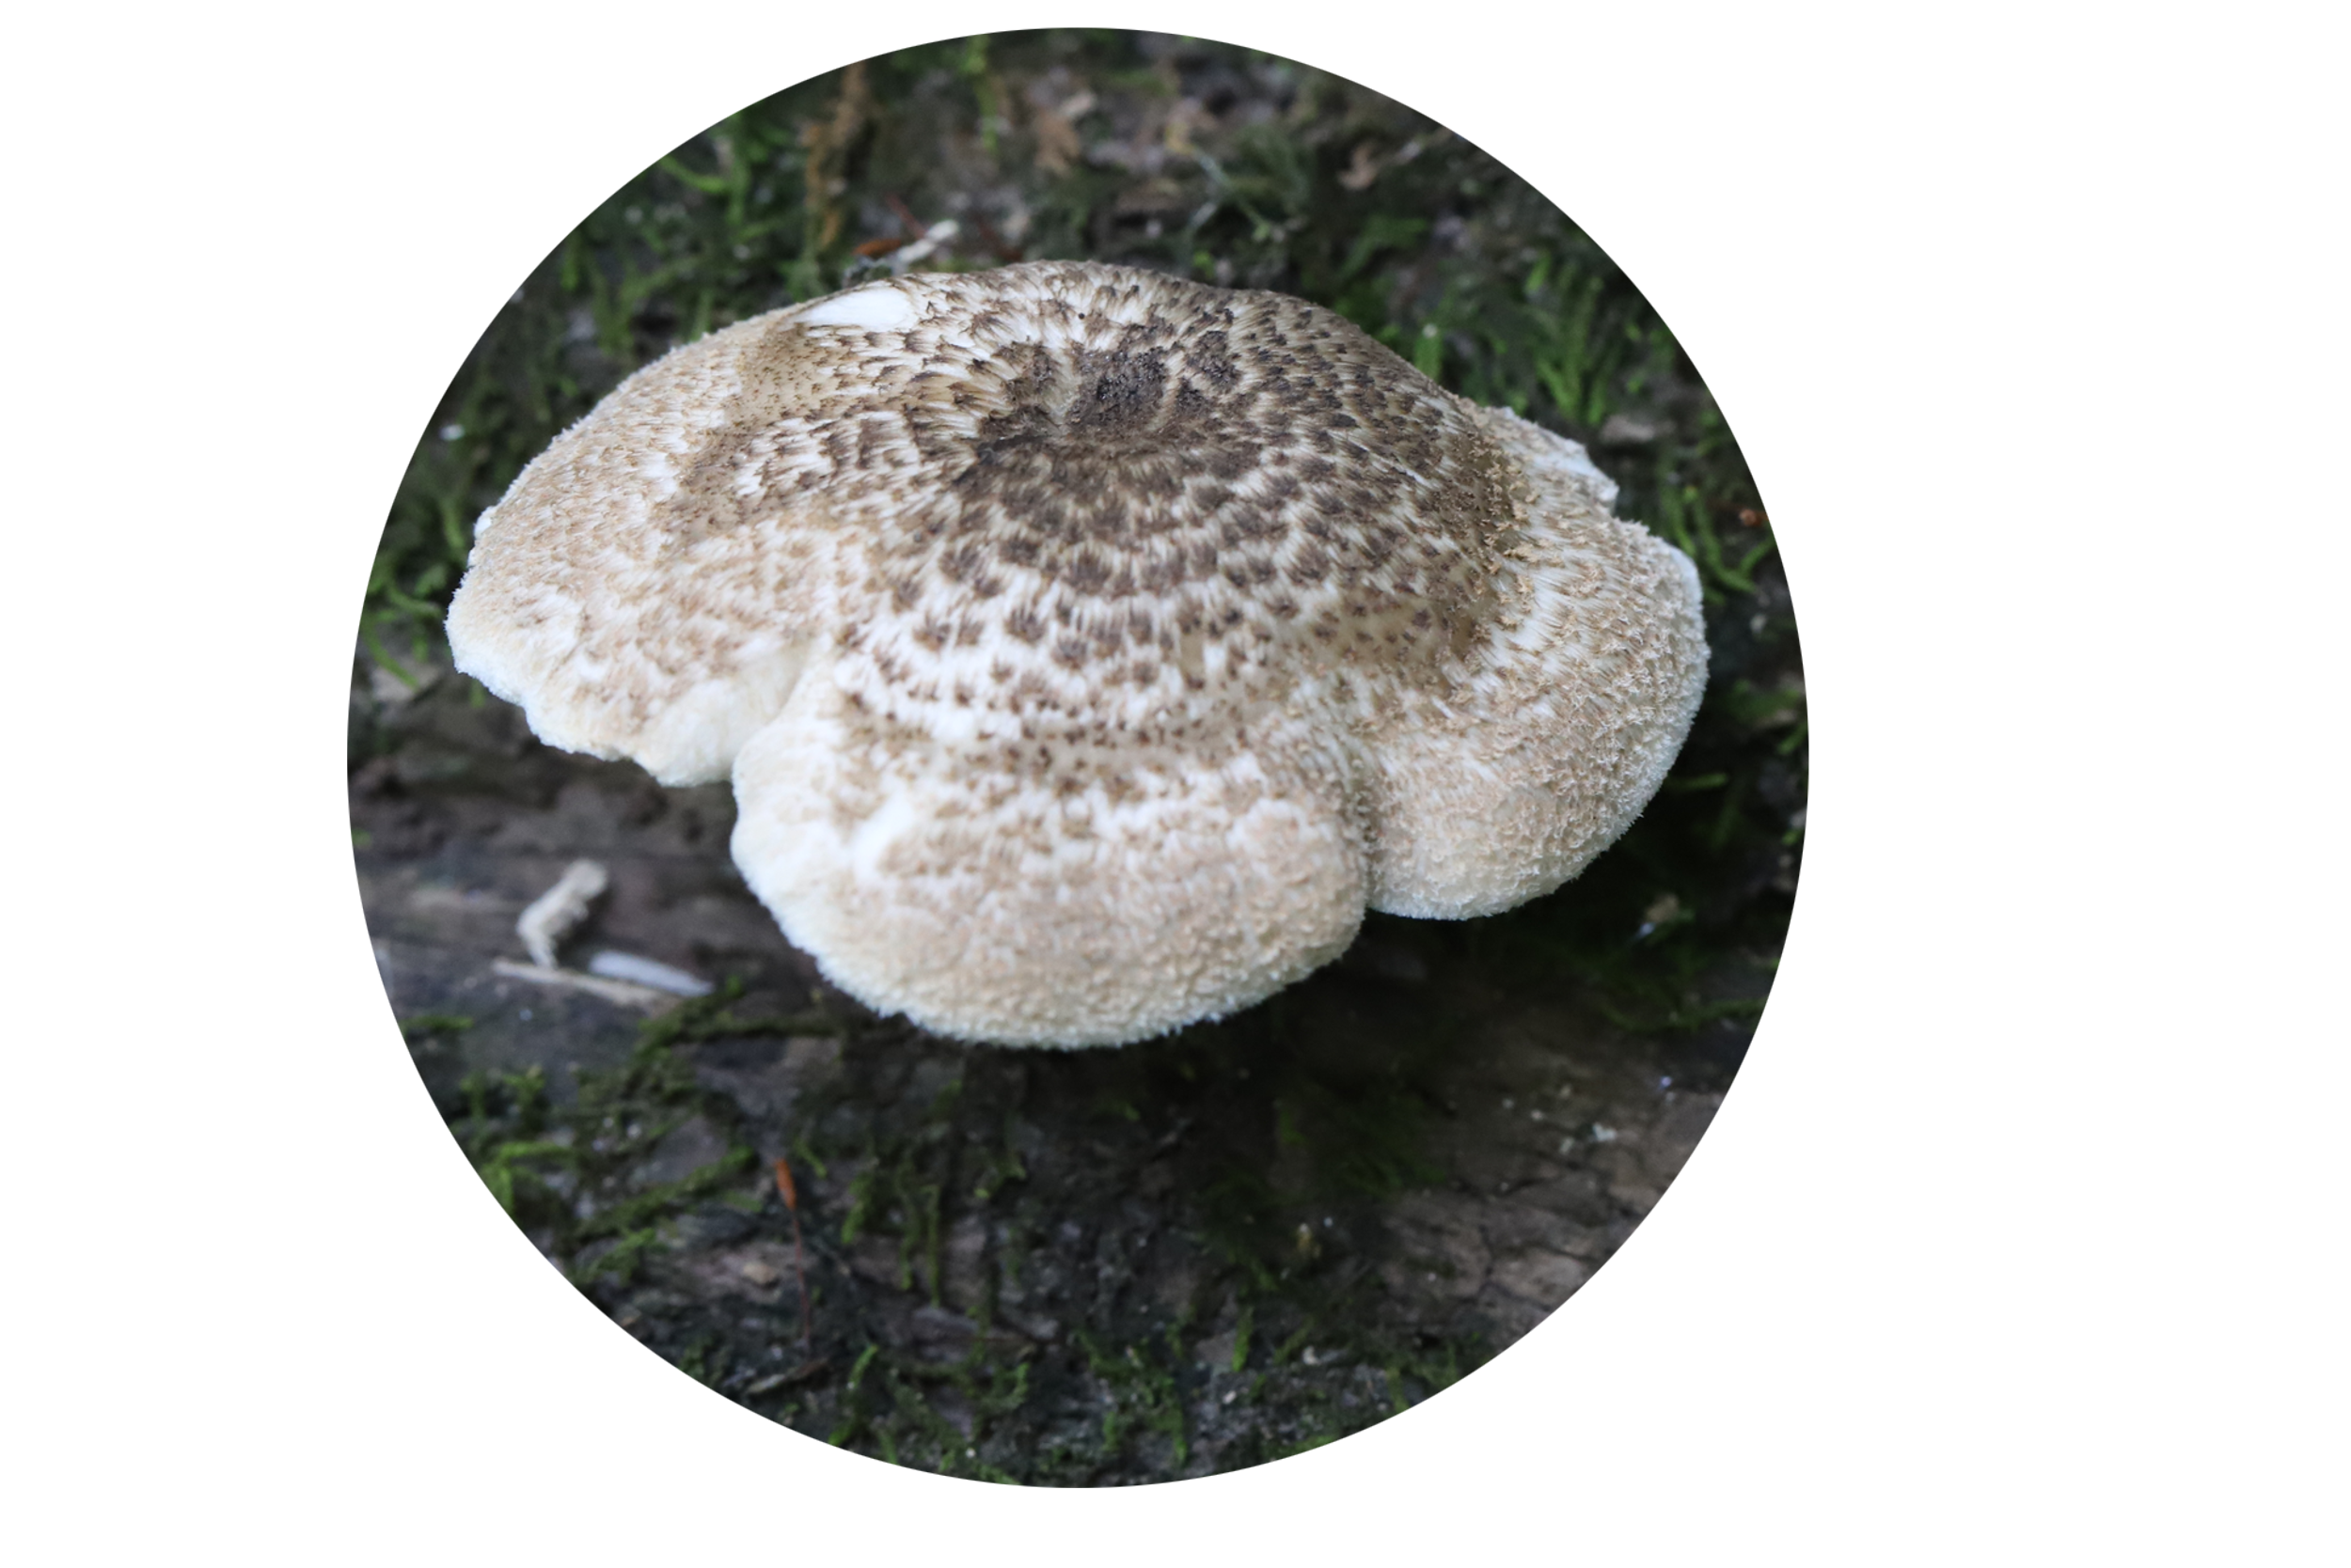




Genome sequencing
and Annotation of Lentinus Section Tigrini
Maximum Likelihood phylogeny
1000 bootstrap replicates
# of Specimens
Annotation flowchart
Annotation stats
Zachary Kratz, Issac Perkis, Alexander James Bradshaw, David S. Hibbett
Clark University, Worcester MA
Introduction
Lentinus tigrinus is a white rot fungus commonly found across Europe and parts of North America, growing on riverbeds and partially submerged logs. L. tigrinus exhibits an enigmatic phylogenetic divergence between North American and European populations. This study presents preliminary genomic analysis of L. tigrinus from both groups in addition to two other species within the section Tigrini, including a possibly novel species of Lentinus in the section Tigrini from Guyana, offering further insights into the diversity of this clade.
Methodology
Genetic analysis
Genome sequencing for eight specimens from section Tigrini, two L. tigrinus from the “North American” group, two from the “European” group, two L. glabratus and two possibly novel Lentinus sp. collected from Guyana in South America, was performed using 150x150 Illumina Novoseq6000. Genomes were assemblied using MegaHit v1.2.9. We used Funannotate (version) to perform genome annotation and comparison against the an of L. tigrinus reference genome, Lenti7.
Phylogenetic Analysis
Curated ITS dataset from UNITE species hypotheses and GenBank accessions across the genus Lentinus. Dataset was modeled around the genus-level Lentinus analysis performed in Seelan et al. 2015. Alignments were done in MAFFT v7.525; phylogenetic tree was constructed and bootstrapped in IQ-TREE v2.3.6.
Busco Score Plot, genome assembly stats, comparison of GO Terms or something else
Conclusions and Future Directions
Issac and Zack, what do you think should happen next
Works cited
Acknowledgements
Terry Henkel for providing material
Citations here
# 2333266

